Slide 1

Technical Seminar on “Content-based recommender system”
Students: Varsha Ravindra (1RN115CS119)
Guide:
Dr. Shashidhara H R
Asst. Prof. Dept. of CSE, RNSIT
Department of Computer Science and Engineering
RNS INSTITUTE OF TECHNOLOGY
2018-19

Slide 2
CONTENTS
INTRODUCTION
LITERATURE SURVEY
GroupLens
Amazon
Netflix
3. FUNDAMENTALS OF CONTENT-BASED RECOMMENDERS
4. HIGH LEVEL ARCHITECTURE
5. CONTENT-BASED RECOMMENDER ALGORITHM
6. IMPLEMENTATION OF CONTENT-BASED RECOMMENDER ALGORITHM
7. ADVANTAGES AND DRAWBACKS IN CONTENT-BASED FILTERING
8. CONCLUSION

Slide 3


INTRODUCTION
A recommender system is an information filtering system that seeks to predict the “rating” or “preference” that a user would give an item.
Recommender systems are used in a variety of areas including movies, music, news, books, research articles, social tags and products in general.
The best use-case of a recommender system is Netflix. More than 80% of the TV shows that people watch on Netflix are discovered through the platform’s recommendation system.

Slide 4


LITERATURE SURVEY
GroupLens :
GroupLens was a pioneering recommender system, which was built as a research prototype for recommendation of Usenet news.
The system collected ratings from Usenet readers and used them to predict whether or not other readers would like an article before they read it.

Slide 5


Amazon :
The recommendations in Amazon.com are provided on the basis of explicitly provided ratings, buying behaviour, and browsing behaviour.
The customer-specific buying and browsing data can be easily collected when users are logged in with an account authentication mechanism supported by Amazon.

Slide 6

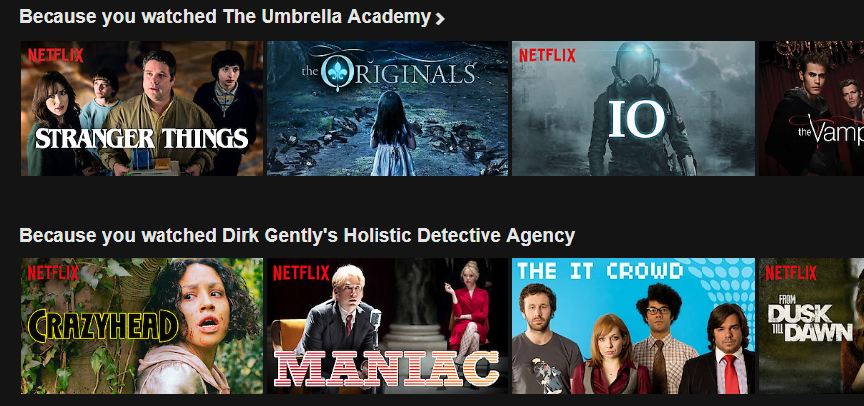
Netflix :
Netflix provides users the ability to rate the movies and television shows to make recommendations. The user actions in terms of watching various items are also stored .
It explicitly provides examples of recommendations based on specific items that were watched by the user

Slide 7
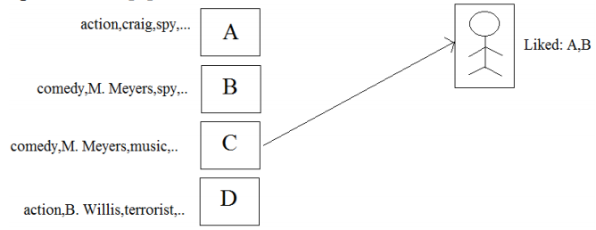
FUNDAMENTALS OF CONTENT-BASED RECOMENDERS
In Content based approach, the descriptive attributes of items are used to make recommendations.
Here, the ratings, buying and browsing behaviour of the user is combined with the content information available in the items.
In content-based approach, the recommendations of items is related qualities or insights of the objects.

Slide 8
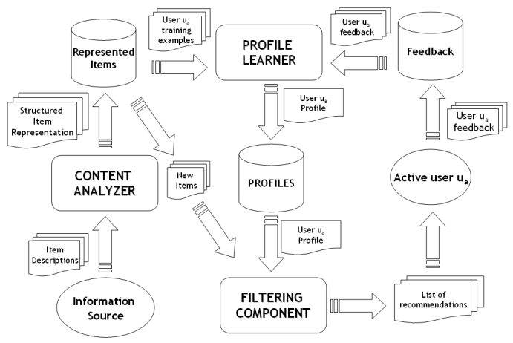
HIGH LEVEL ARCHITECTURE OF CONTENT-BASED RECOMMENDERS

Slide 9
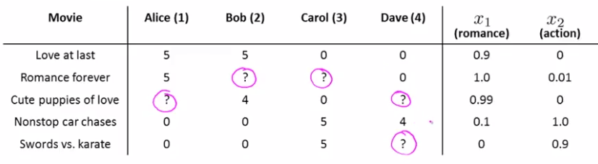
CONTENT-BASED RECOMMENDER ALGORITHM
Consider the below example:
What we’d like to do here is, look at these users and predict how they would rate the movies that they haven’t rated yet.
Let’s suppose each of these movies has a set of features x1, x2 which measures the degree to which a movie is romantic and an action movie.

Slide 10
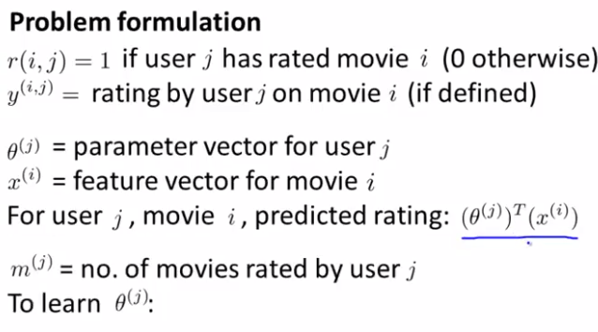
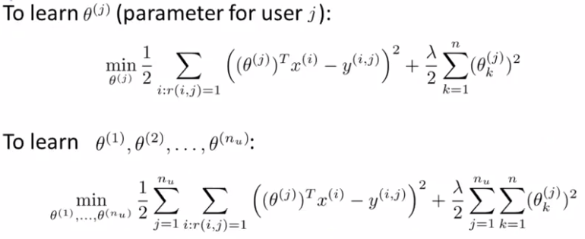

Slide 11
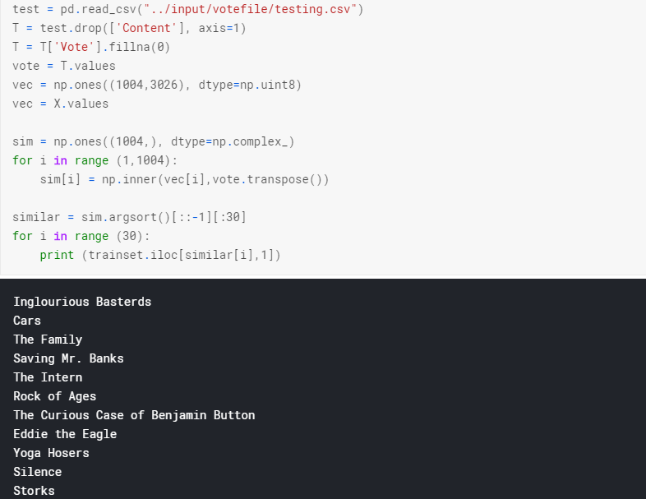
IMPLEMENTATION OF CONTENT-BASED RECOMMENDER ALGORITHM

Slide 12
ADVANTAGES AND DRAWBACKS
Drawbacks :
Limited content analysis
Over specialization
New User
Advantages :
User Independence
Transparency
New Item

Slide 13
CONCLUSION
Content based filtering method is a domain-dependent and it highlights largely on the exploration of the features of items to produce predictions.
Content based filtering approach is the utmost successful method in predicting documents such as news, web pages and publications.
CBF method has the capability to change its recommendations with changes occurs in user profile within a very short period of time.
CBF uses diverse types of prototypes to discover match between articles or documents for producing meaningful recommendations like keyword based model (Vector Space Model) for example, TF/IDF (Term Frequency Inverse Document Frequency).

Slide 14
REFERENCES
[1] Deepa Mandave, Govind S. Pole ″A Review on Content Based Recommendation System”, Vol. 4, Issue 11, November 2016 Lü L, Medo M, Yeung C H, et al. Recommender systems[J]. Physics Reports, 2012, 519(1): 1-49.USA: Abbrev. of Publisher, year
[2] Recommender Systems, Aggarwal
[3] Pasquale Lops, Marco de Gemmis and Giovanni Semeraro “Content-based Recommender Systems: State of the Art and Trends”
[4] Michael J. Pazzani and Daniel Billsus “Content-Based Recommendation Systems”

Slide 15
THANK YOU!!!

